Slide 1

3
Analytic Functions
Book: A First Course in Complex Analysis with Applications by Dennis G. Zill and
Patrick D. Shanahan.

Slide 2
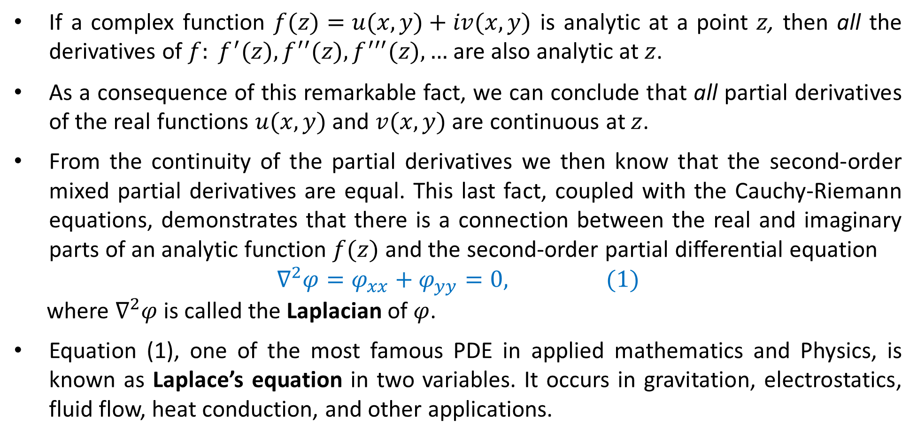
Laplace Equation
If a complex function $f(z)=u(x,y)+iv(x,y)$ is analytic at a point $z$, then all the derivatives of $f: f^{′}(z),f^{′′}(z),f^{′′′}(z), …$ are also analytic at $z$.
As a consequence of this remarkable fact, we can conclude that all partial derivatives of the real functions $u(x, y)$ and $v(x, y)$ are continuous at $z$.
From the continuity of the partial derivatives we then know that the second-order mixed partial derivatives are equal. This last fact, coupled with the Cauchy-Riemann equations, demonstrates that there is a connection between the real and imaginary parts of an analytic function $f(z)$ and the second-order partial differential equation
$$∇^{2}φ=φ_{xx}+φ_{yy}=0, (1)$$
where $∇^{2}φ$ is called the Laplacian of $φ$.
Equation (1), one of the most famous PDE in applied mathematics and Physics, is known as Laplace’s equation in two variables. It occurs in gravitation, electrostatics, fluid flow, heat conduction, and other applications.

Slide 3
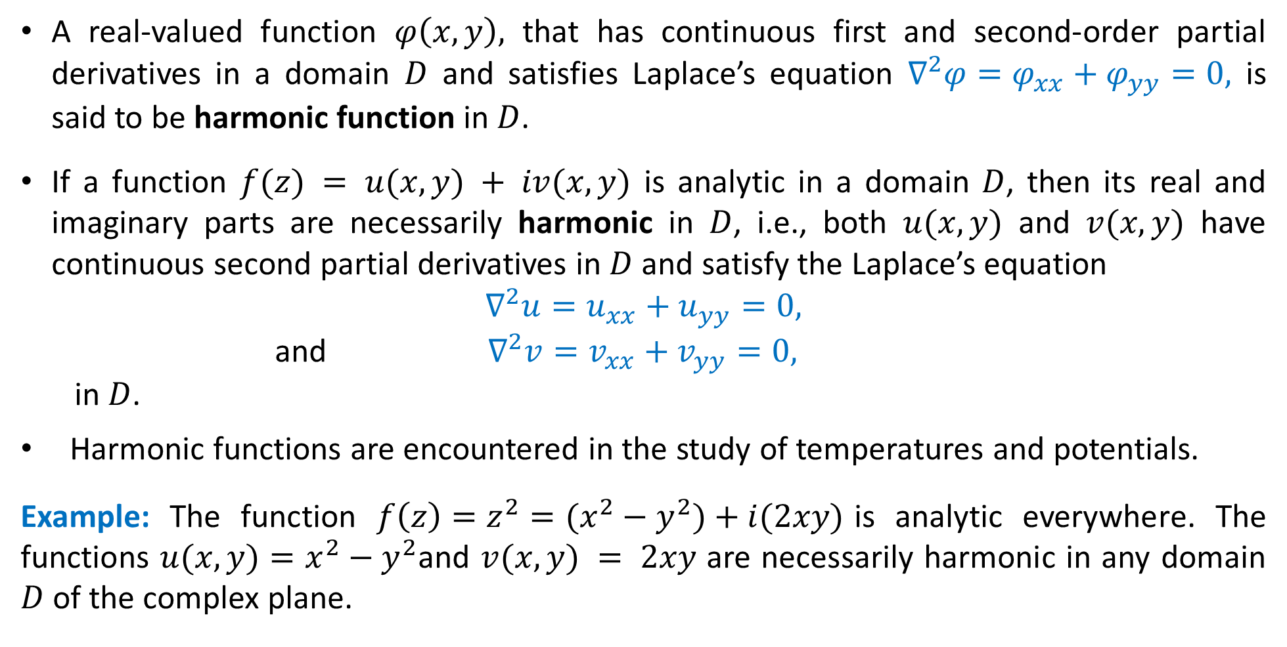
Harmonic Function
A real-valued function $φ\left(x,y\right),$ that has continuous first and second-order partial derivatives in a domain $D$ and satisfies Laplace’s equation $∇^{2}φ=φ_{xx}+φ_{yy}=0,$ is said to be harmonic function in $D$.
If a function $f(z) = u(x, y) + iv(x, y)$ is analytic in a domain $D$, then its real and imaginary parts are necessarily harmonic in $D$, i.e., both $u(x,y)$ and $v(x,y)$ have continuous second partial derivatives in $D$ and satisfy the Laplace’s equation
$$∇^{2}u=u_{xx}+u_{yy}=0,$$
and $∇^{2}v=v_{xx}+v_{yy}=0,$
in $D$.
Harmonic functions are encountered in the study of temperatures and potentials.
Example: The function $f\left(z\right)=z^{2}=(x^{2}−y^{2})+i(2xy)$is analytic everywhere. The functions $u(x, y)=x^{2}−y^{2}$and $v(x, y) = 2xy$ are necessarily harmonic in any domain $D$ of the complex plane.

Slide 4
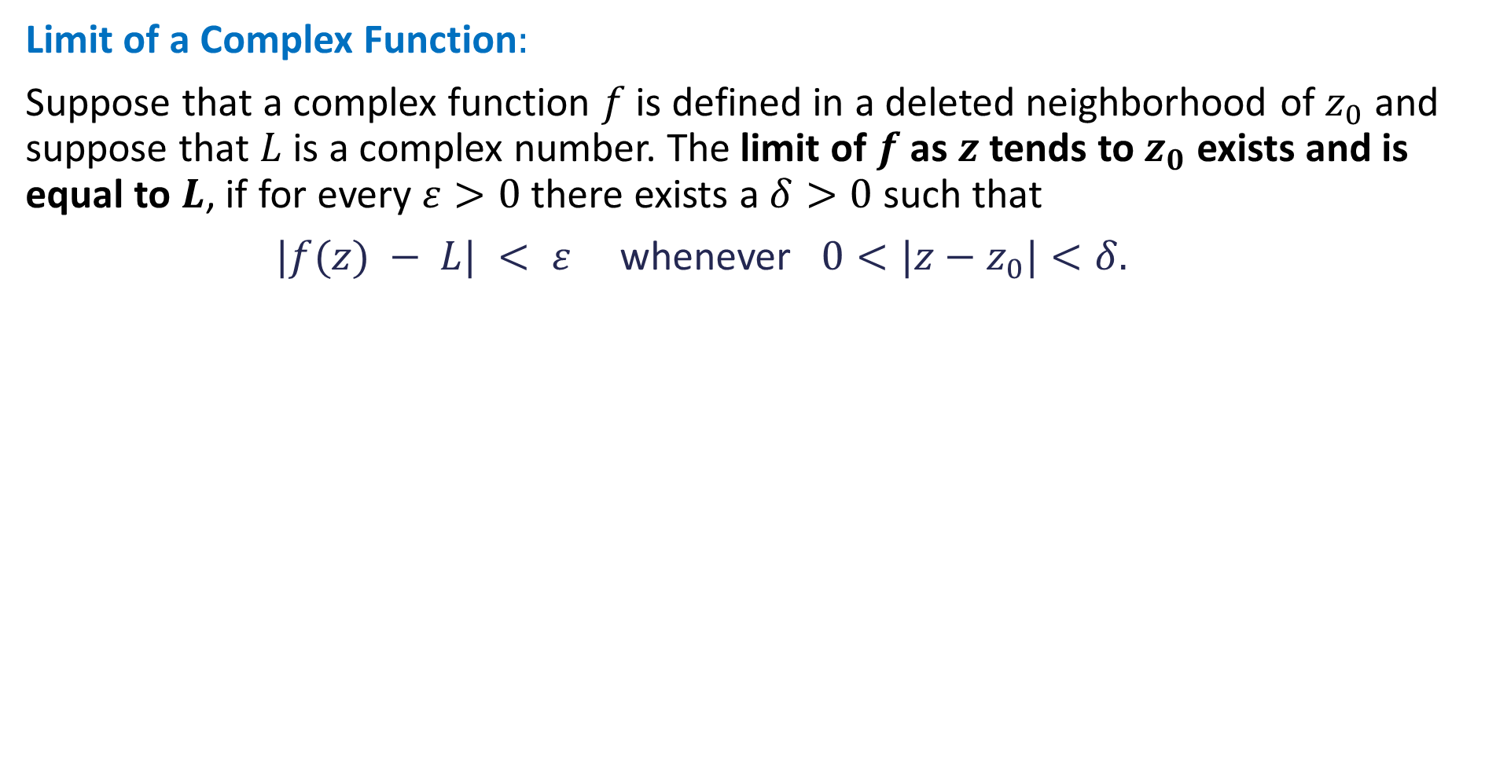
Harmonic Conjugate Functions
Now suppose $u(x, y)$ is a given real function that is known to be harmonic in D.
If it is possible to find another real harmonic function $v(x, y)$ so that $u$ and $v$ satisfy the Cauchy-Riemann equations throughout the domain $D$, then the function $v(x, y)$ is called a harmonic conjugate of $u(x, y)$. (Of course, this has absolutely nothing to do with the use of “conjugate” for $\overline{z}$.)
By combining the functions as $u\left(x, y\right)+iv(x, y)$ we obtain a function that is analytic in $D$.

Slide 5
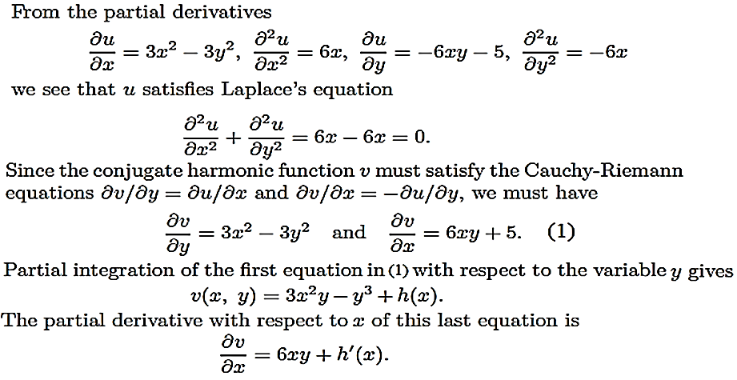
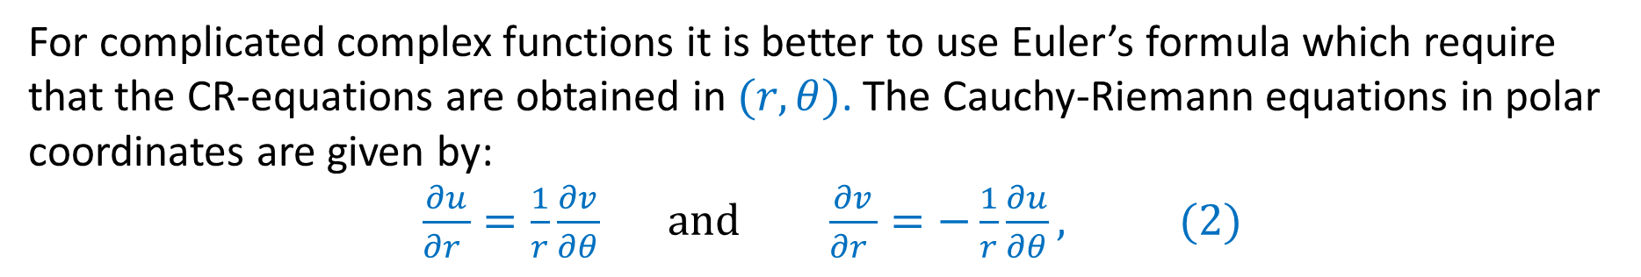
Example:
Verify that the function $u\left(x, y\right)=x^{3}−3xy^{2}−5y$is harmonic in the entire complex plane. Moreover, determine the harmonic conjugate function of $u.$

Slide 6
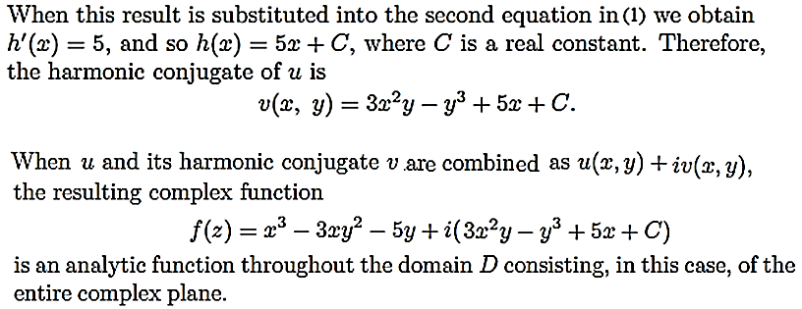

Slide 7
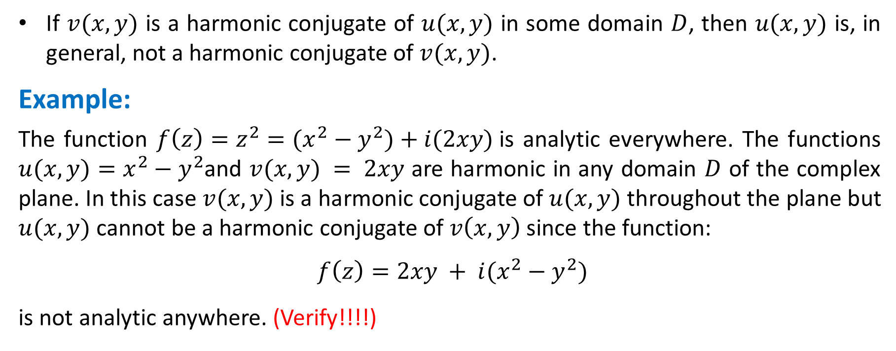
Remark:
If $v(x, y)$ is a harmonic conjugate of $u(x, y)$ in some domain $D$, then $u(x, y)$ is, in general, not a harmonic conjugate of $v(x, y)$.
Example:
The function $f\left(z\right)=z^{2}=(x^{2}−y^{2})+i(2xy)$is analytic everywhere. The functions $u(x, y)=x^{2}−y^{2}$and $v(x, y) = 2xy$ are harmonic in any domain $D$ of the complex plane. In this case $v(x, y)$ is a harmonic conjugate of $u(x, y)$ throughout the plane but $u(x, y)$ cannot be a harmonic conjugate of $v\left(x, y\right)$ since the function:
$f\left(z\right)=2xy + i(x^{2}−y^{2})$
is not analytic anywhere. (Verify!!!!)

Slide 8
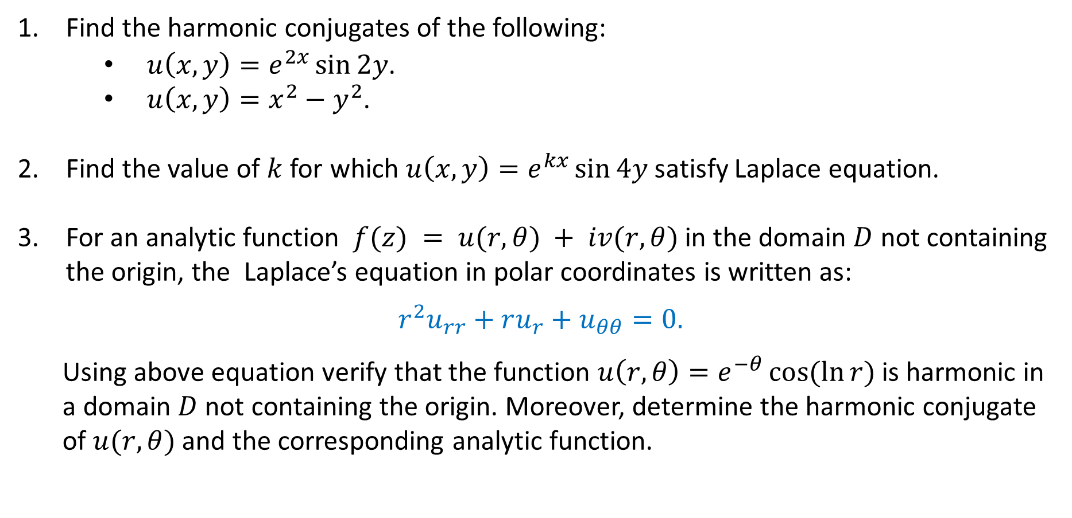
Examples:
Find the harmonic conjugates of the following:
$u\left(x,y\right)=e^{2x}\sin{2y}$.
$u\left(x,y\right)=x^{2}−y^{2}$.
Find the value of $k$ for which $u\left(x,y\right)=e^{kx}\sin{4y}$ satisfy Laplace equation.
For an analytic function $f(z) = u(r, θ) + iv(r, θ)$ in the domain $D$ not containing the origin, the Laplace’s equation in polar coordinates is written as:
$$r^{2}u_{rr}+ru_{r}+u_{θθ}=0.$$
Using above equation verify that the function $u\left(r,θ\right)=e^{−θ}\cos{(\ln{r})}$ is harmonic in
a domain $D$ not containing the origin. Moreover, determine the harmonic conjugate
of $u(r,θ)$ and the corresponding analytic function.

Slide 9
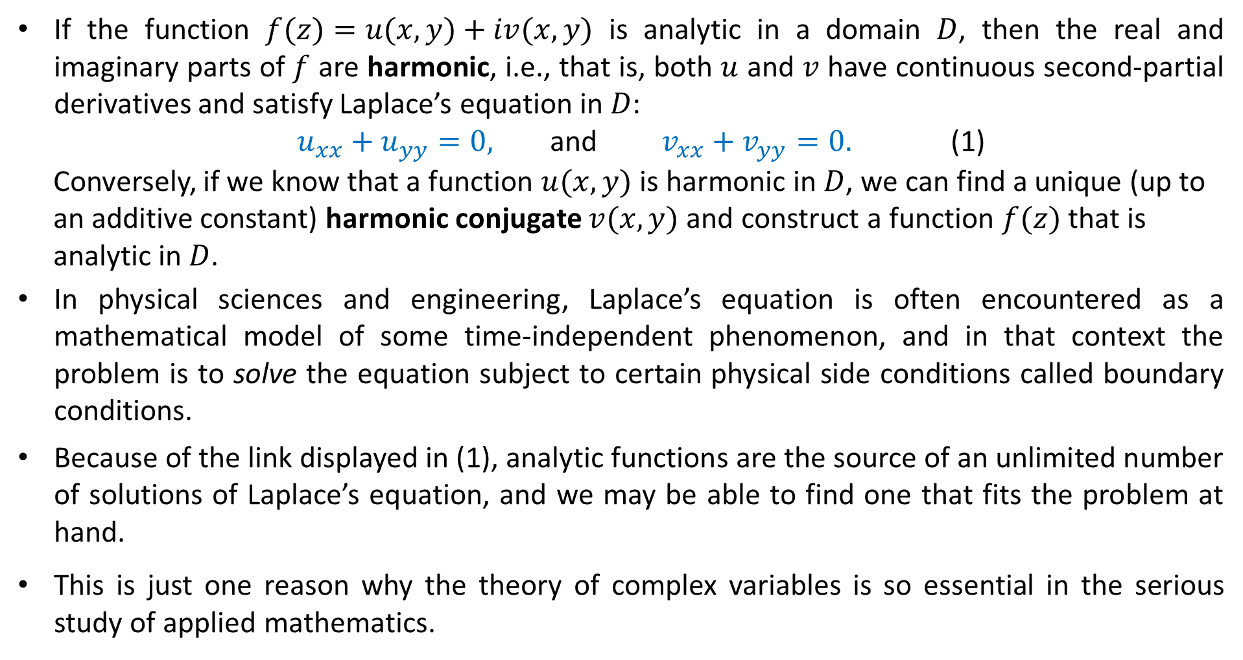
Applications:
If the function $f(z)=u(x,y)+iv(x,y)$ is analytic in a domain $D$, then the real and imaginary parts of $f$ are harmonic, i.e., that is, both $u$ and $v$ have continuous second-partial derivatives and satisfy Laplace’s equation in $D$:
$u_{xx}+u_{yy}=0,$ and $v_{xx}+v_{yy}=0.$ (1)
Conversely, if we know that a function $u(x,y)$ is harmonic in $D$, we can find a unique (up to
an additive constant) harmonic conjugate $v(x,y)$ and construct a function $f(z)$ that is
analytic in $D$.
In physical sciences and engineering, Laplace’s equation is often encountered as a mathematical model of some time-independent phenomenon, and in that context the problem is to solve the equation subject to certain physical side conditions called boundary conditions.
Because of the link displayed in (1), analytic functions are the source of an unlimited number of solutions of Laplace’s equation, and we may be able to find one that fits the problem at hand.
This is just one reason why the theory of complex variables is so essential in the serious study of applied mathematics.

Slide 10
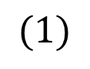
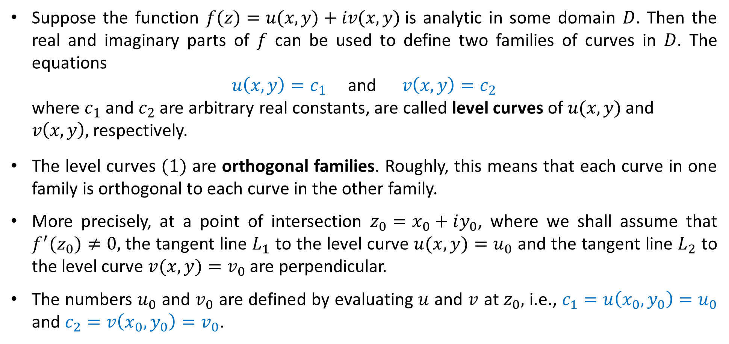
Orthogonal Families
Suppose the function $f(z)=u(x, y)+iv(x, y)$is analytic in some domain $D$. Then the real and imaginary parts of $f$ can be used to define two families of curves in $D$. The equations
$u\left(x,y\right)=c_{1}$ and $v\left(x,y\right)=c_{2}$
where $c_{1}$ and $c_{2}$ are arbitrary real constants, are called level curves of $u(x,y)$ and
$v\left(x,y\right),$ respectively.
The level curves $(1)$ are orthogonal families. Roughly, this means that each curve in one family is orthogonal to each curve in the other family.
More precisely, at a point of intersection $z_{0}=x_{0}+iy_{0}$, where we shall assume that $f^{′}(z_{0})≠0,$ the tangent line $L_{1}$ to the level curve $u(x, y)=u_{0}$ and the tangent line $L_{2}$ to the level curve $v(x, y)=v_{0}$ are perpendicular.
The numbers $u_{0}$ and $v_{0}$ are defined by evaluating $u$ and $v$ at $z_{0},$ i.e., $c_{1}=u\left(x_{0},y_{0}\right)=u_{0}$ and $c_{2}=v\left(x_{0},y_{0}\right)=v_{0}$.
$$(1)$$

Slide 11
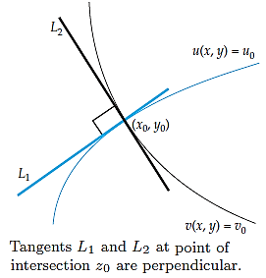
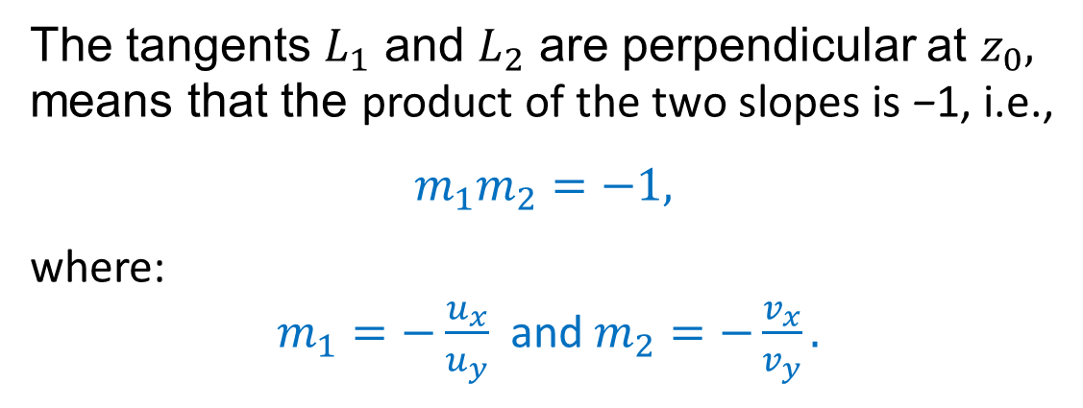
Orthogonal Families
The tangents $L_{1}$ and $L_{2}$ are perpendicular at $z_{0},$ means that the product of the two slopes is −1, i.e.,
$$m_{1}m_{2}=−1,$$
where:
$m_{1}=−\frac{u_{x}}{u_{y}}$ and $m_{2}=−\frac{v_{x}}{v_{y}}.$

Slide 12
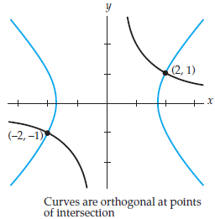
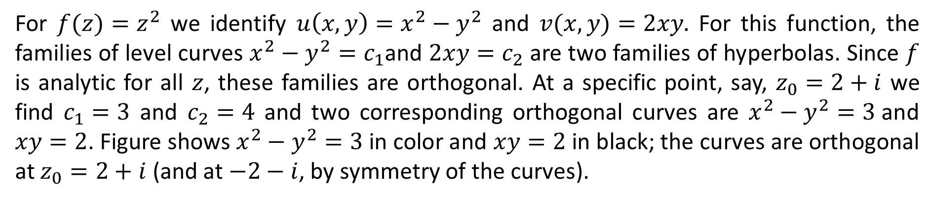
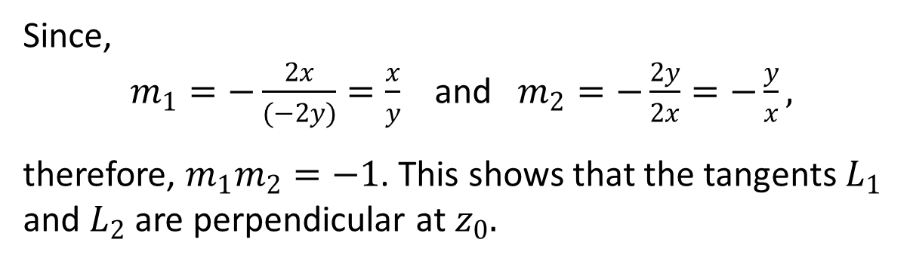
Example:
For $f(z)=z^{2}$ we identify $u\left(x, y\right)=x^{2}−y^{2}$ and $v(x, y)=2xy.$ For this function, the families of level curves $x^{2}−y^{2}=c_{1}$and $2xy=c_{2}$ are two families of hyperbolas. Since $f$ is analytic for all $z$, these families are orthogonal. At a specific point, say, $z_{0}=2+i$ we find $c_{1}=3$ and $c_{2}=4$ and two corresponding orthogonal curves are $x^{2}−y^{2}=3$and $xy=2$. Figure shows $x^{2}−y^{2}=3$in color and $xy=2$ in black; the curves are orthogonal at $z_{0}=2+i$ (and at $−2−i$, by symmetry of the curves).
Since,
$m_{1}=−\frac{2x}{(−2y)}=\frac{x}{y}$ and $m_{2}=−\frac{2y}{2x}=−\frac{y}{x},$
therefore, $m_{1}m_{2}=−1$. This shows that the tangents $L_{1}$ and $L_{2}$ are perpendicular at $z_{0}.$

Slide 13
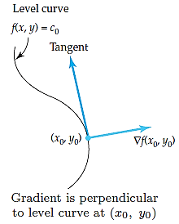
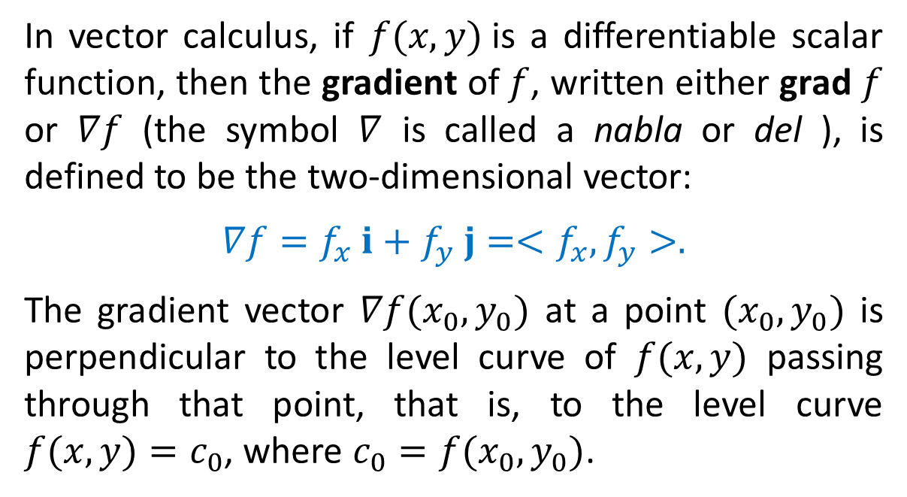
Gradient Vector
In vector calculus, if $f(x, y)$is a differentiable scalar function, then the gradient of $f$, written either grad $f$ or $∇f$ (the symbol $∇$ is called a nabla or del ), is defined to be the two-dimensional vector:
$∇f=f_{x} i+f_{y} j=<f_{x},f_{y}>.$
The gradient vector $∇f(x_{0},y_{0})$ at a point $(x_{0},y_{0})$ is perpendicular to the level curve of $f(x, y)$ passing through that point, that is, to the level curve $f(x, y)=c_{0}$, where $c_{0}=f(x_{0},y_{0})$.

Slide 14
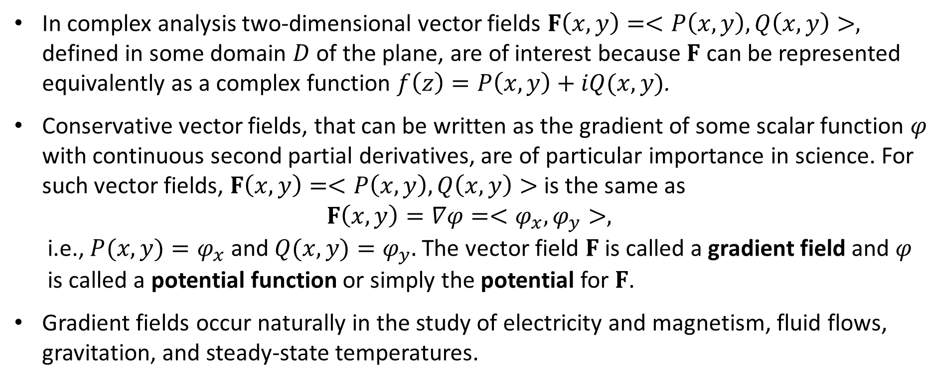
Gradient Fields
In complex analysis two-dimensional vector fields $F\left(x, y\right)=<P\left(x, y\right),Q\left(x, y\right)>,$ defined in some domain $D$ of the plane, are of interest because $F$ can be represented equivalently as a complex function $f\left(z\right)=P\left(x, y\right)+iQ(x, y)$.
Conservative vector fields, that can be written as the gradient of some scalar function $φ$ with continuous second partial derivatives, are of particular importance in science. For such vector fields, $F\left(x, y\right)=<P\left(x, y\right),Q\left(x, y\right)>$ is the same as
$$F\left(x,y\right)=∇φ=<φ_{x},φ_{y}>,$$
i.e., $P(x, y)=φ_{x}$ and $Q(x, y)=φ_{y}.$ The vector field $F$ is called a gradient field and $φ$
is called a potential function or simply the potential for $F$.
Gradient fields occur naturally in the study of electricity and magnetism, fluid flows, gravitation, and steady-state temperatures.

Slide 15
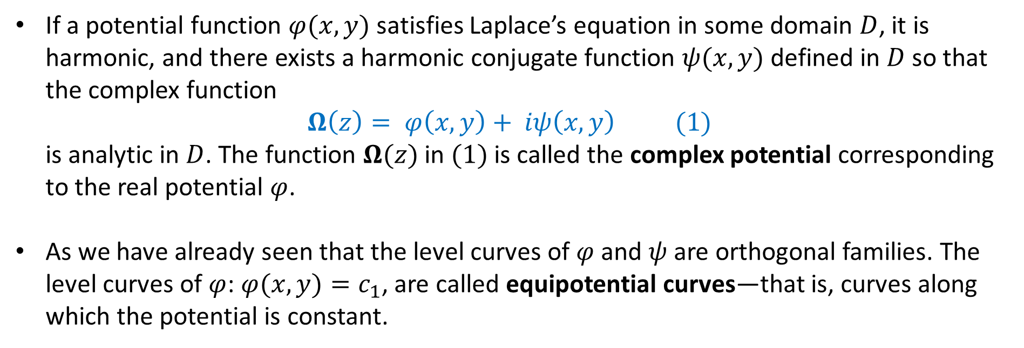
Complex potential.
If a potential function $φ(x, y)$satisfies Laplace’s equation in some domain $D$, it is harmonic, and there exists a harmonic conjugate function $ψ(x, y)$defined in $D$ so that the complex function
$$Ω\left(z\right)= φ\left(x, y\right)+ iψ\left(x, y\right) (1)$$
is analytic in $D$. The function $Ω(z)$ in $(1)$ is called the complex potential corresponding
to the real potential $φ$.
As we have already seen that the level curves of $φ$ and $ψ$ are orthogonal families. The level curves of $φ$: $φ(x, y)=c_{1}$, are called equipotential curves—that is, curves along which the potential is constant.

Slide 16
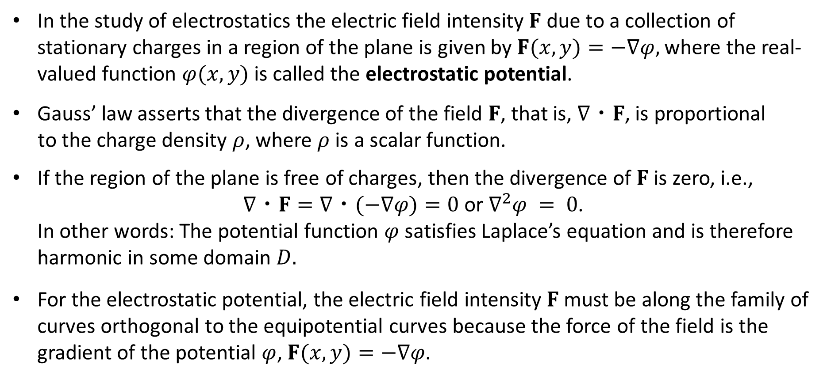
Electrostatic potential.
In the study of electrostatics the electric field intensity $F$ due to a collection of stationary charges in a region of the plane is given by $F(x, y)=−∇φ,$ where the real-valued function $φ(x, y)$is called the electrostatic potential.
Gauss’ law asserts that the divergence of the field $F$, that is, $∇・F$, is proportional
to the charge density $ρ$, where $ρ$ is a scalar function.
If the region of the plane is free of charges, then the divergence of $F$ is zero, i.e.,
$∇・F=∇・(−∇φ)=0$ or $∇^{2}φ = 0$.
In other words: The potential function $φ$ satisfies Laplace’s equation and is therefore
harmonic in some domain $D.$
For the electrostatic potential, the electric field intensity $F$ must be along the family of curves orthogonal to the equipotential curves because the force of the field is the gradient of the potential $φ$, $F(x, y)=−∇φ$.

Slide 17
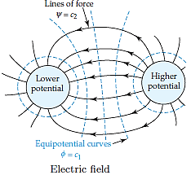
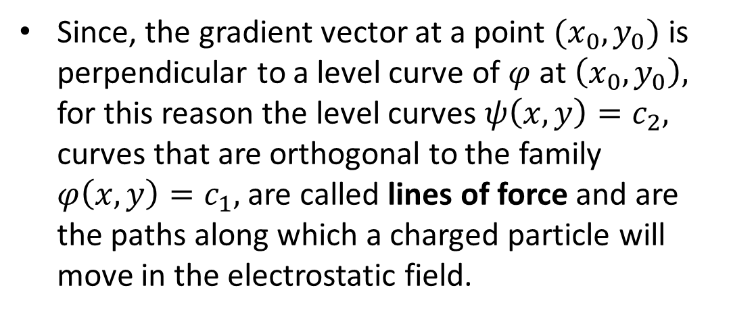
Electrostatic potential.
Since, the gradient vector at a point $(x_{0},y_{0})$ is perpendicular to a level curve of $φ$ at $\left(x_{0},y_{0}\right),$ for this reason the level curves $ψ\left(x, y\right)=c_{2},$ curves that are orthogonal to the family $φ\left(x, y\right)=c_{1},$ are called lines of force and are the paths along which a charged particle will move in the electrostatic field.

Slide 18
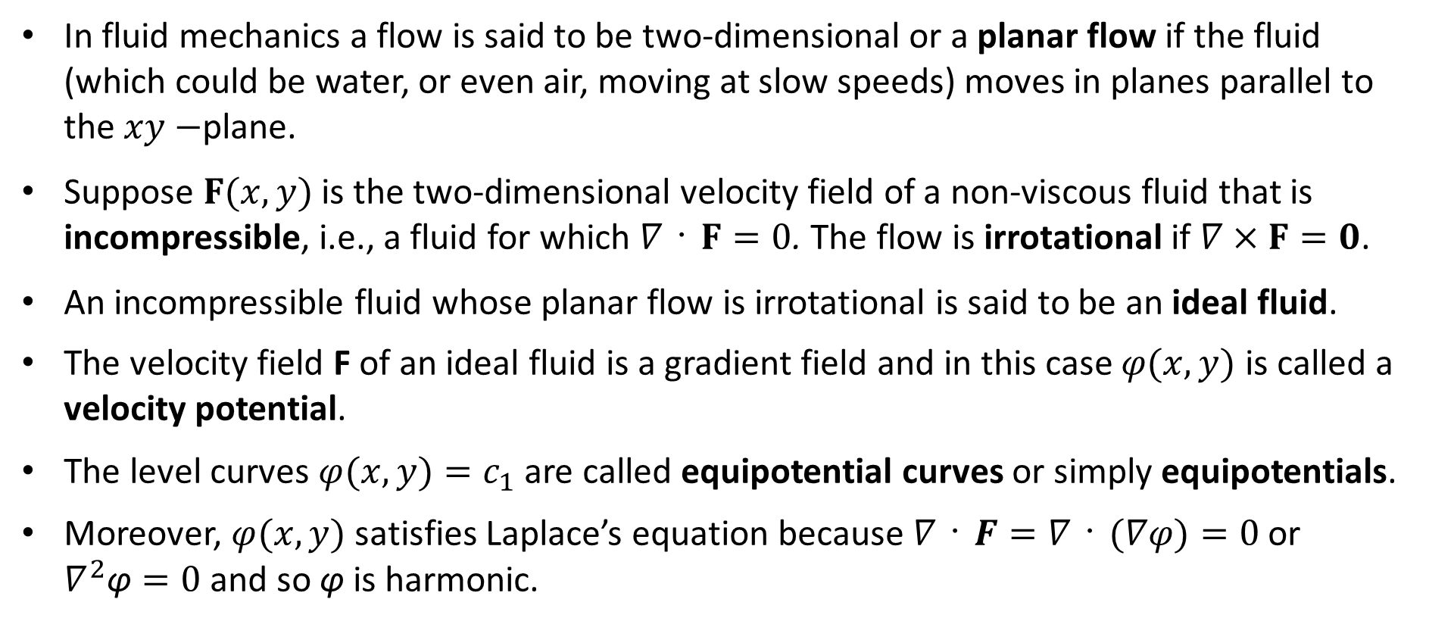
Ideal Fluid
In fluid mechanics a flow is said to be two-dimensional or a planar flow if the fluid (which could be water, or even air, moving at slow speeds) moves in planes parallel to the $xy−$plane.
Suppose $F(x, y)$is the two-dimensional velocity field of a non-viscous fluid that is incompressible, i.e., a fluid for which $∇・F=0$. The flow is irrotational if $∇×F=0$.
An incompressible fluid whose planar flow is irrotational is said to be an ideal fluid.
The velocity field F of an ideal fluid is a gradient field and in this case $φ(x,y)$ is called a velocity potential.
The level curves $φ(x, y)=c_{1}$ are called equipotential curves or simply equipotentials.
Moreover, $φ(x,y)$ satisfies Laplace’s equation because $∇・F=∇・(∇φ)=0$ or $∇^{2}\text{φ}=0$and so φ is harmonic.

Slide 19
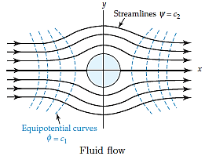
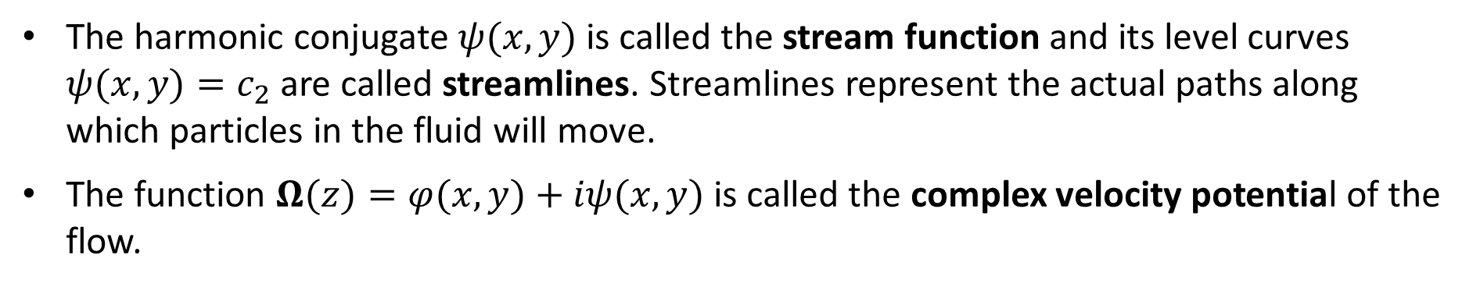
Ideal Fluid
The harmonic conjugate $ψ(x, y)$is called the stream function and its level curves $ψ(x, y)=c_{2}$are called streamlines. Streamlines represent the actual paths along which particles in the fluid will move.
The function $Ω(z)=φ(x,y)+iψ(x,y)$ is called the complex velocity potential of the flow.

Slide 20
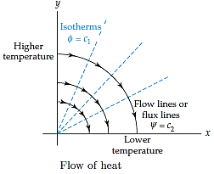
Heat Flow
If $φ(x, y)$ represents time-independent or steady-state temperature that satisfies Laplace’s equation, then the level curves $φ(x, y)=c_{1}$ are curves along which the temperature is constant and are called isotherms.
The level curves $ψ(x, y)=c_{2}$ of the harmonic conjugate function of $φ(x,y)$ are the curves along which heat flows and are called flow lines or flux lines.

Slide 21
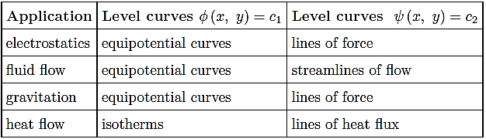
Complex Potentials.
Following table summarizes some of the applications of the complex potential function Ω(z) and the names given to the level curves $φ(x, y)=c_{1}$and $ψ(x, y)=c_{2}$.
Complex potential function $Ω(z) = φ(x, y) + iψ(x, y)$

Slide 22
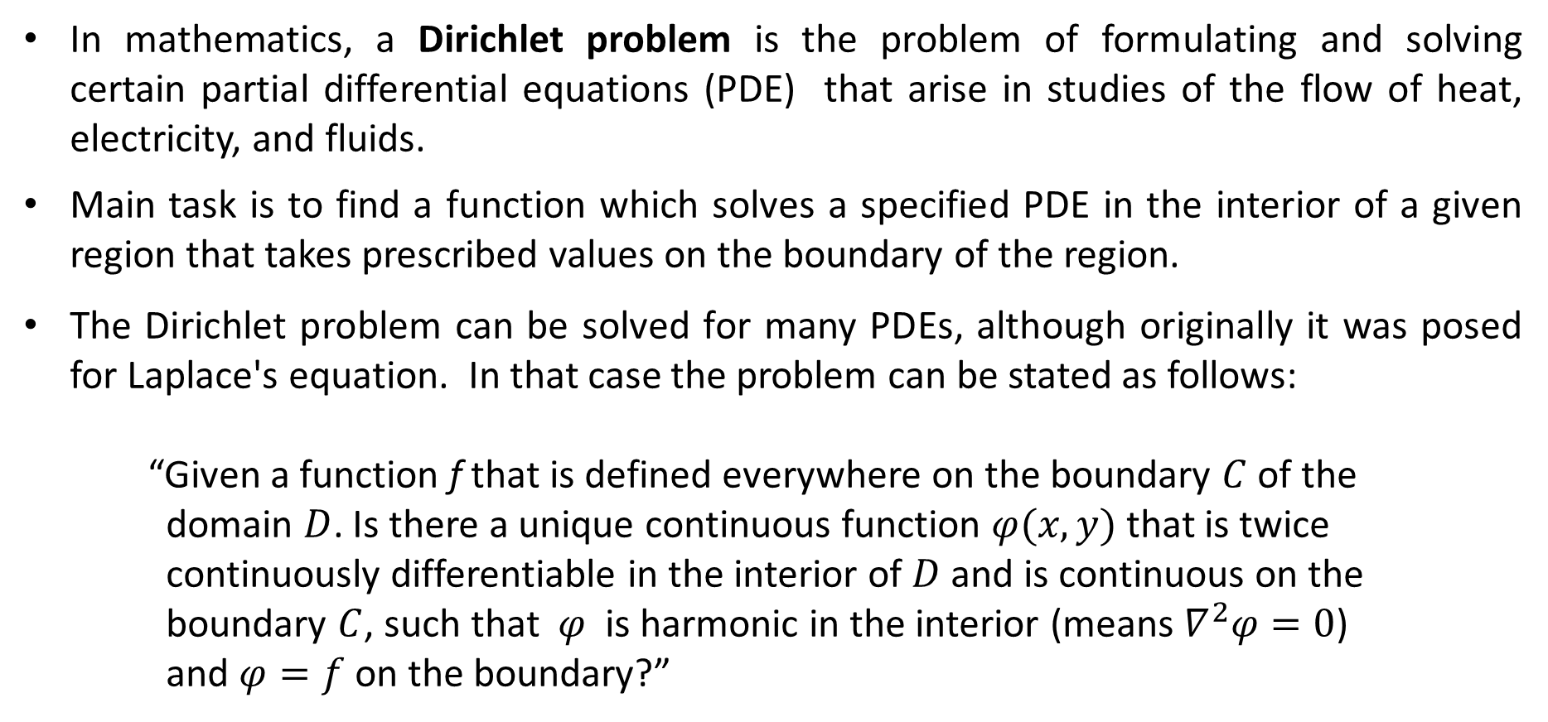
Example: Dirichlet Problem
In mathematics, a Dirichlet problem is the problem of formulating and solving certain partial differential equations (PDE) that arise in studies of the flow of heat, electricity, and fluids.
Main task is to find a function which solves a specified PDE in the interior of a given region that takes prescribed values on the boundary of the region.
The Dirichlet problem can be solved for many PDEs, although originally it was posed for Laplace's equation. In that case the problem can be stated as follows:
“Given a function f that is defined everywhere on the boundary $C$ of the
domain $D$. Is there a unique continuous function $φ(x,y)$ that is twice continuously differentiable in the interior of $D$ and is continuous on the boundary $C$, such that $φ$ is harmonic in the interior (means $∇^{2}φ=0$) and $φ=f$ on the boundary?”

Slide 23
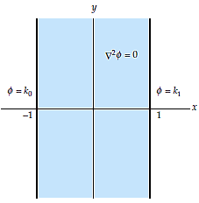
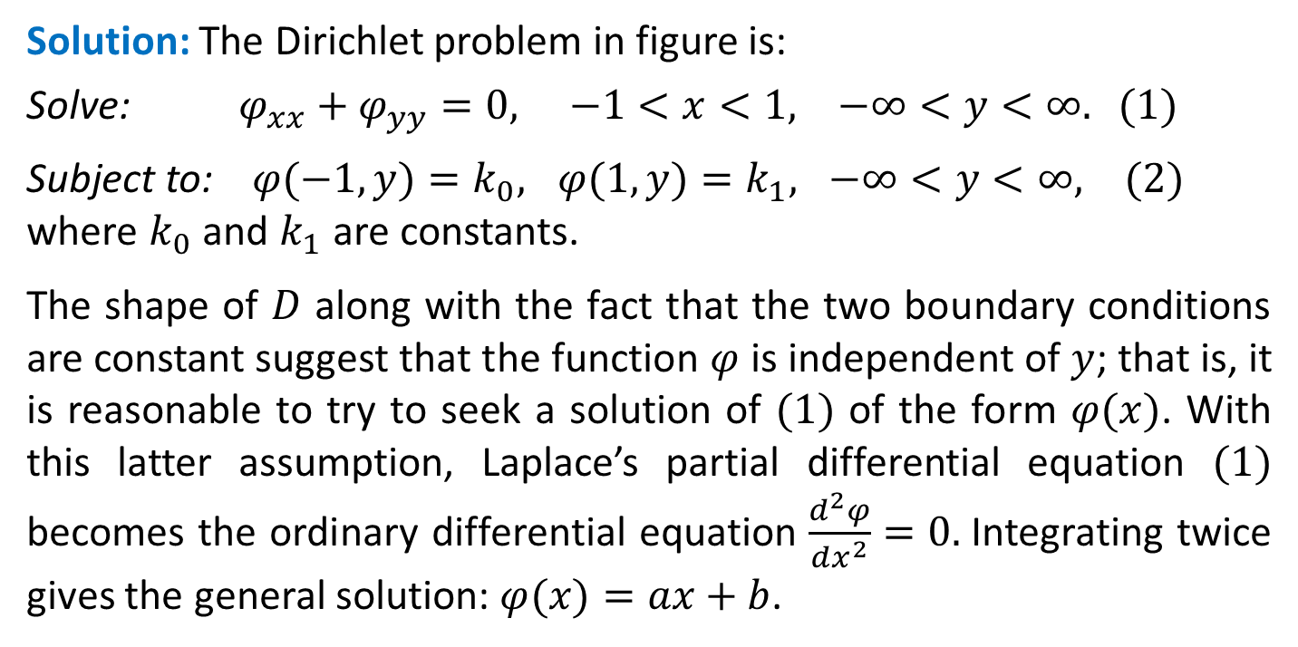
Example: Dirichlet Problem
Solve the Dirichlet problem illustrated in figure. The domain $D$ is a vertical infinite strip defined by $−1 < x < 1, −∞ < y < ∞$; the boundaries of D are the vertical lines $x = −1$and $x = 1$.
Solution: The Dirichlet problem in figure is:
Solve: $φ_{xx}+φ_{yy}=0, −1<x<1, −∞<y<∞. (1)$
Subject to: $φ(−1, y)=k_{0}, φ(1, y)=k_{1}, −∞<y<∞, (2)$
where $k_{0}$ and $k_{1}$ are constants.
The shape of $D$ along with the fact that the two boundary conditions are constant suggest that the function $φ$ is independent of $y$; that is, it is reasonable to try to seek a solution of $(1)$ of the form $φ(x)$. With this latter assumption, Laplace’s partial differential equation $(1)$ becomes the ordinary differential equation $\frac{d^{2}φ}{dx^{2}}=0.$Integrating twice gives the general solution: $φ(x)=ax+b$.

Slide 24
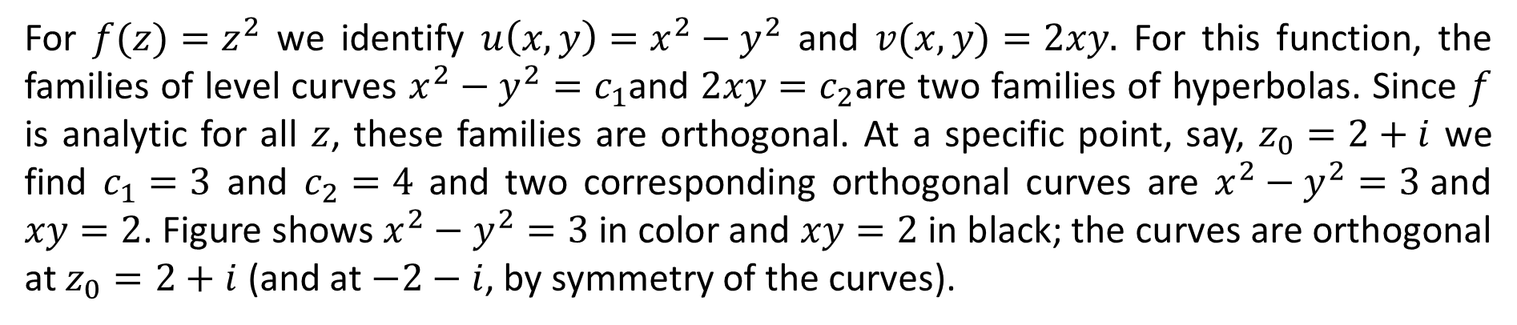
The boundary conditions enable us to solve for the coefficients $a$ and $b$. In particular, from $φ(−1)=k_{0}$ and $φ(1)=k_{1}$ we must have $a(−1)+b=k_{0}$ and $a(1)+b=k_{1}$, respectively. Adding the two simultaneous equations gives $2b=k_{0}+k_{1}$, whereas subtracting the first equation from the second yields $2a=k_{1}−k_{0}$. These two results give us $a$ and $b$. Therefore, we have the following solution of the given Dirichlet problem
$$φ\left(x\right)=\frac{k_{1}−k_{0}}{2}x+\frac{k_{1}+k_{0}}{2} (3)$$
Note that this problem can be interpreted as the determination the electrostatic potential $φ$ between two infinitely long parallel conducting plates that are held at constant potentials. Since it satisfies Laplace’s equation in $D$, $φ$ is a harmonic function. Hence a harmonic conjugate $ψ$ can be found as follows. Because $φ$ and $ψ$ must satisfy the Cauchy-Riemann equations, we have:
$ψ_{y}=φ_{x}=\frac{k_{1}−k_{0}}{2}$ and $ψ_{x}={−φ}_{y}=0.$
The second equation indicates that $ψ$ is a function of $y$ alone, and so integrating the first equation with respect to $y$ we obtain: $ψ\left(y\right)=\frac{k_{1}−k_{0}}{2}y,$ where, for convenience, we have taken the constant of integration to be 0.

Slide 25
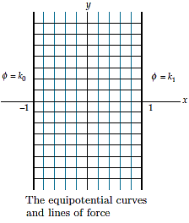

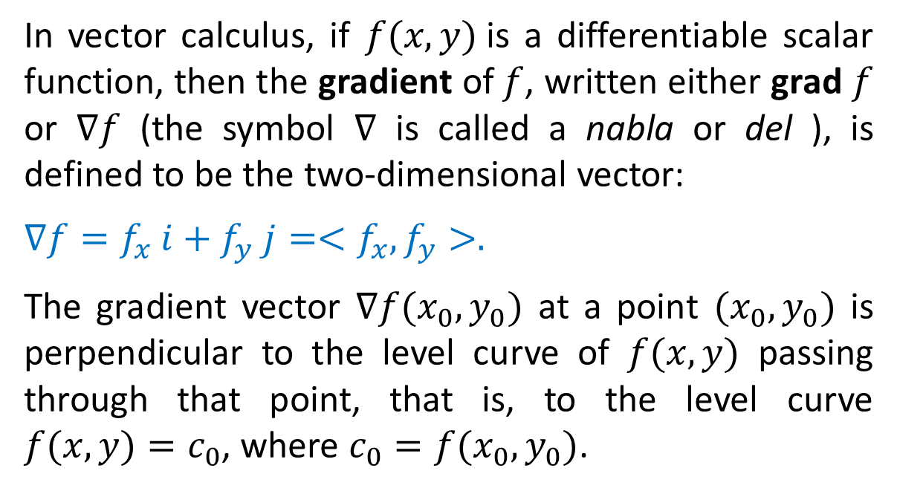
A complex potential function for the Dirichlet problem under consideration is then
$Ω\left(z\right)= φ\left(x\right)+ iψ\left(y\right)=\frac{k_{1}−k_{0}}{2}x+\frac{k_{1}+k_{0}}{2}+i\frac{k_{1}−k_{0}}{2}y$
The level curves of $φ$ or equipotential curves are the vertical lines $x=c_{1},$ shown in color in the figure, and the level curves of $ψ$ or the lines of force are the horizontal line segments $y=c_{2}$ shown in black. The figure clearly shows that the two families of level curves are orthogonal.

Slide 26
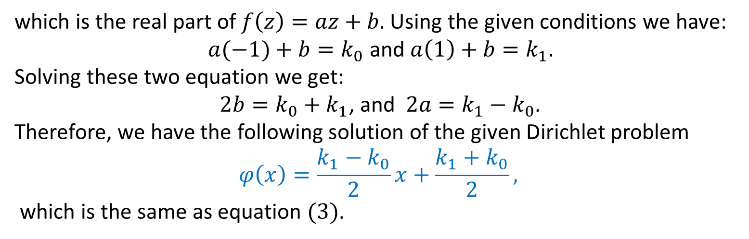
Alternative solution:
Given that $φ$ takes constant values on the left and right edges, i.e.,
$φ(−1, y)=k_{0}, φ(1, y)=k_{1}, −∞<y<∞,$
where $k_{0}$ and $k_{1}$ are constants.
Consider $φ\left(x, y\right)=x,$ the real part of the analytic function $f\left(z\right)=z.$ This real multivariable function $φ\left(x, y\right)$ is harmonic and constant along the vertical line. To accommodate the given boundary conditions for the steady-state temperature in the slab we take
$φ\left(x,y\right)=ax+b,$
which is the real part of $f\left(z\right)=az+b.$ Using the given conditions we have:
$a(−1)+b=k_{0}$ and $a\left(1\right)+b=k_{1}.$
Solving these two equation we get:
$2b=k_{0}+k_{1}$, and $2a=k_{1}−k_{0}$.
Therefore, we have the following solution of the given Dirichlet problem
$$φ\left(x\right)=\frac{k_{1}−k_{0}}{2}x+\frac{k_{1}+k_{0}}{2},$$
which is the same as equation $(3)$.

Slide 27
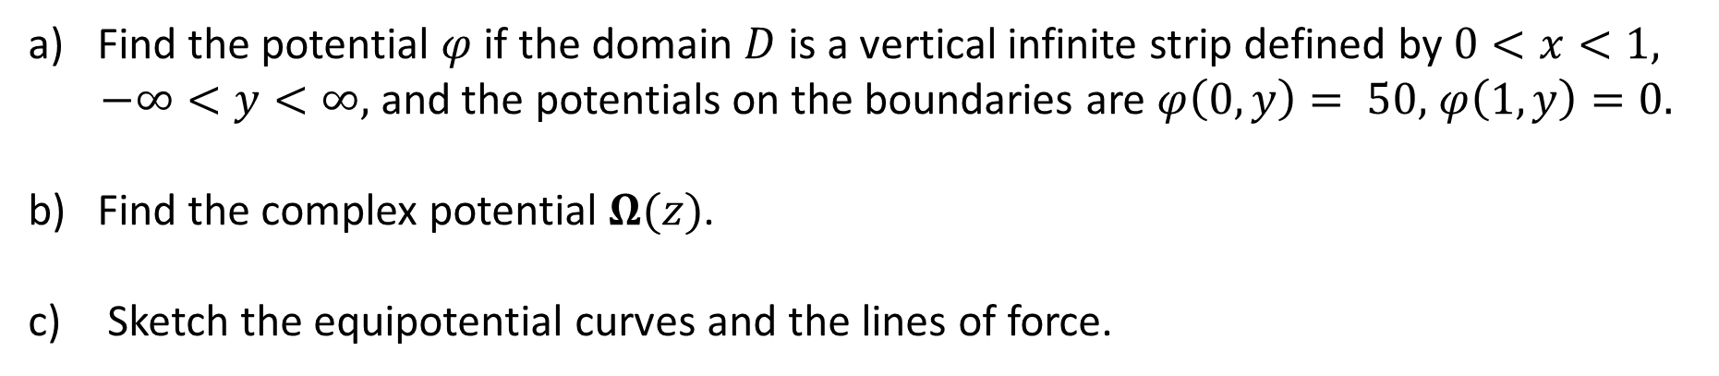
Example:
Find the potential $φ$ if the domain $D$ is a vertical infinite strip defined by $0<x<1,$
$−∞<y<∞,$ and the potentials on the boundaries are $φ\left(0, y\right)= 50,$ $φ\left(1, y\right)=0.$
Find the complex potential $Ω(z)$.
Sketch the equipotential curves and the lines of force.

Slide 28
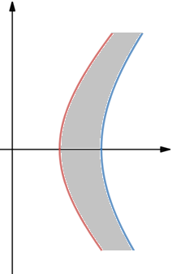
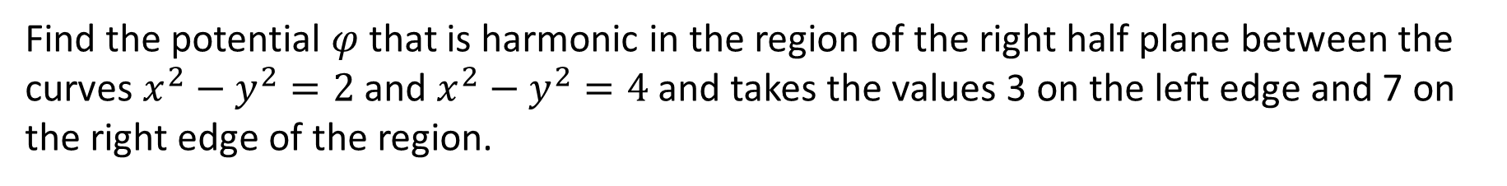
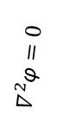

Example:
Find the potential $φ$ that is harmonic in the region of the right half plane between the curves $x^{2}−y^{2}=2$ and $x^{2}−y^{2}=4$ and takes the values 3 on the left edge and 7 on the right edge of the region.
Solution: We recognize $x^{2}−y^{2}$ as the real part of analytic function $f\left(z\right)=z^{2},$ so the boundary curves are the level curves of a known harmonic function. To meet the specified boundary conditions we add some flexibility by considering:
$φ\left(x,y\right)=a\left(x^{2}−y^{2}\right)+b=Re\left(az^{2}+b \right),$
where $a$ and $b$ are constants that need to be determined. Note that:
When $x^{2}−y^{2}=2, φ=3; a\left(2\right)+b=3.$
When $x^{2}−y^{2}=4, φ=7; a\left(4\right)+b=7.$
Solving the above two equations we get: $a=2 ,b=−1$ and we have:
$$φ\left(x,y\right)=2\left(x^{2}−y^{2}\right)−1.$$
$x^{2}−y^{2}=2$
$x^{2}−y^{2}=4$
$$∇^{2}\text{φ}=0$$
$$\text{φ}=3$$
$$\text{φ}=7$$

Slide 29
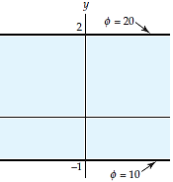
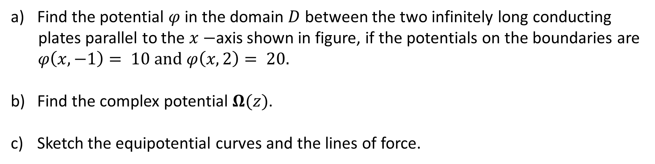
Example:
Find the potential $φ$ in the domain $D$ between the two infinitely long conducting
plates parallel to the $x−$axis shown in figure, if the potentials on the boundaries are $φ\left(x, −1\right)= 10 and φ\left(x, 2\right)= 20.$
Find the complex potential $Ω(z)$.
Sketch the equipotential curves and the lines of force.

Slide 30
Practice Questions
Exercise 3.1:
Q-1 to Q-30
Exercise 3.2:
Q-1 to Q-25, Q-35
Exercise 3.3:
Q-1 to Q-20
Exercise 3.4:
Q-1 to Q-14

Slide 31
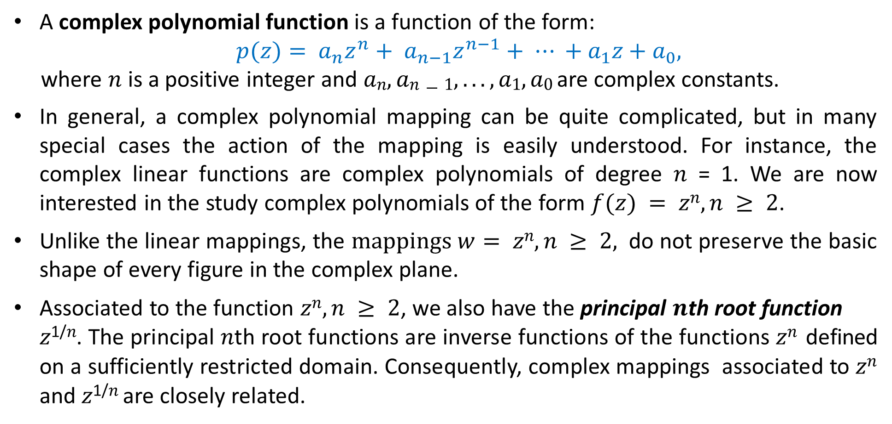

$2.4:$ Special Power Functions
A complex polynomial function is a function of the form:
$$p(z)= a_{n}z^{n}+ a_{n−1}z^{n−1}+ ⋯ +a_{1}z+a_{0},$$
where $n$ is a positive integer and $an, an−1, . . . , a1, a0$are complex constants.
In general, a complex polynomial mapping can be quite complicated, but in many special cases the action of the mapping is easily understood. For instance, the complex linear functions are complex polynomials of degree 𝑛 = 1. We are now interested in the study complex polynomials of the form $f(z) = zn, n ≥ 2$.
Unlike the linear mappings, the $mappings w= zn, n ≥ 2,$ do not preserve the basic shape of every figure in the complex plane.
Associated to the function $zn, n ≥ 2$, we also have the principal 𝒏th root function
𝑧^{1/𝑛}. The principal 𝑛th root functions are inverse functions of the functions 𝑧^{𝑛} defined on a sufficiently restricted domain. Consequently, complex mappings associated to 𝑧^{𝑛} and 𝑧^{1/𝑛} are closely related.

Slide 32
Power Functions
A complex power function is a function of the form $f(z) = zα$where $α$ is a complex constant.
If 𝛼 is an integer, then the power function $zα$ can be evaluated using the algebraic operations on complex numbers. For example, $z2 = z. z$ and $z^{−3}={(z. z. z)}^{−3}$.
We can also use the formulas for taking roots of complex numbers to define power functions with fractional exponents of the form 1/𝑛. For instance, we can define 𝑧^{1/4} to be the function that gives the principal fourth root of 𝑧.
In this section we will restrict our attention to special complex power functions of the form 𝑧^{𝑛} and 𝑧^{1/𝑛} where 𝑛 ≥ 2 and 𝑛 is an integer.

Slide 33
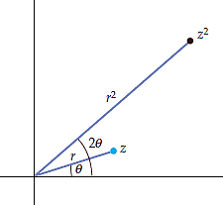
The Power Function 𝒛^{𝟐}
Values of the complex power function $w=f(z)=z2$are easily found using complex multiplication. However, understanding the complex mapping $w=z2$, requires a little more work. In exponential notation we have:
$$w= z2 =r2ei2θ. (1)$$
From $(1)$ we see that the modulus $r2$ of the point $w$ is the square of the modulus 𝑟 of the point 𝑧, and that the argument 2𝜃 of 𝑤 is twice the
argument 𝜃 of 𝑧. If we plot both 𝑧 and 𝑤 in the same copy of the complex plane, then 𝑤 is obtained by magnifying 𝑧 by a factor of 𝑟 and then by rotating the result through the angle 𝜃 about the origin. In figure the relationship between
𝑧 and 𝑤 = 𝑧² when 𝑟 > 1 and 𝜃 > 0. If 0 < 𝑟 < 1, then
𝑧 is contracted by a factor of 𝑟, and if 𝜃 < 0, then the rotation is clockwise.

Slide 34
The Power Function 𝒛^{𝟐}
It is important to note that the magnification or contraction factor and the rotation angle associated to 𝑤 = 𝑓(𝑧) = 𝑧² depend on where the point 𝑧 is located in the complex plane. For example, since 𝑓(2) = 4 and 𝑓(𝑖/2) = −1/4, the point 𝑧 = 2 is magnified by 2 but not rotated, whereas the point 𝑧 = 𝑖/2 is contracted by 1/2 and rotated through 𝜋/4. In general, the squaring function 𝑧² does not magnify the modulus of points on the unit circle |𝑧| = 1 and it does not rotate points on the positive real axis.
The description of the mapping 𝑤 = 𝑧² in terms of a magnification and rotation can be used to visualize the image of some special sets. For example, consider a ray emanating from the origin and making an angle of 𝜑 with the positive real axis. All points on this ray have an argument of 𝜑 and so the images of these points under
𝑤 = 𝑧² have an argument of 2𝜑. Thus, the images lie on a ray emanating from the origin and making an angle of 2𝜑 with the positive real axis.

Slide 35
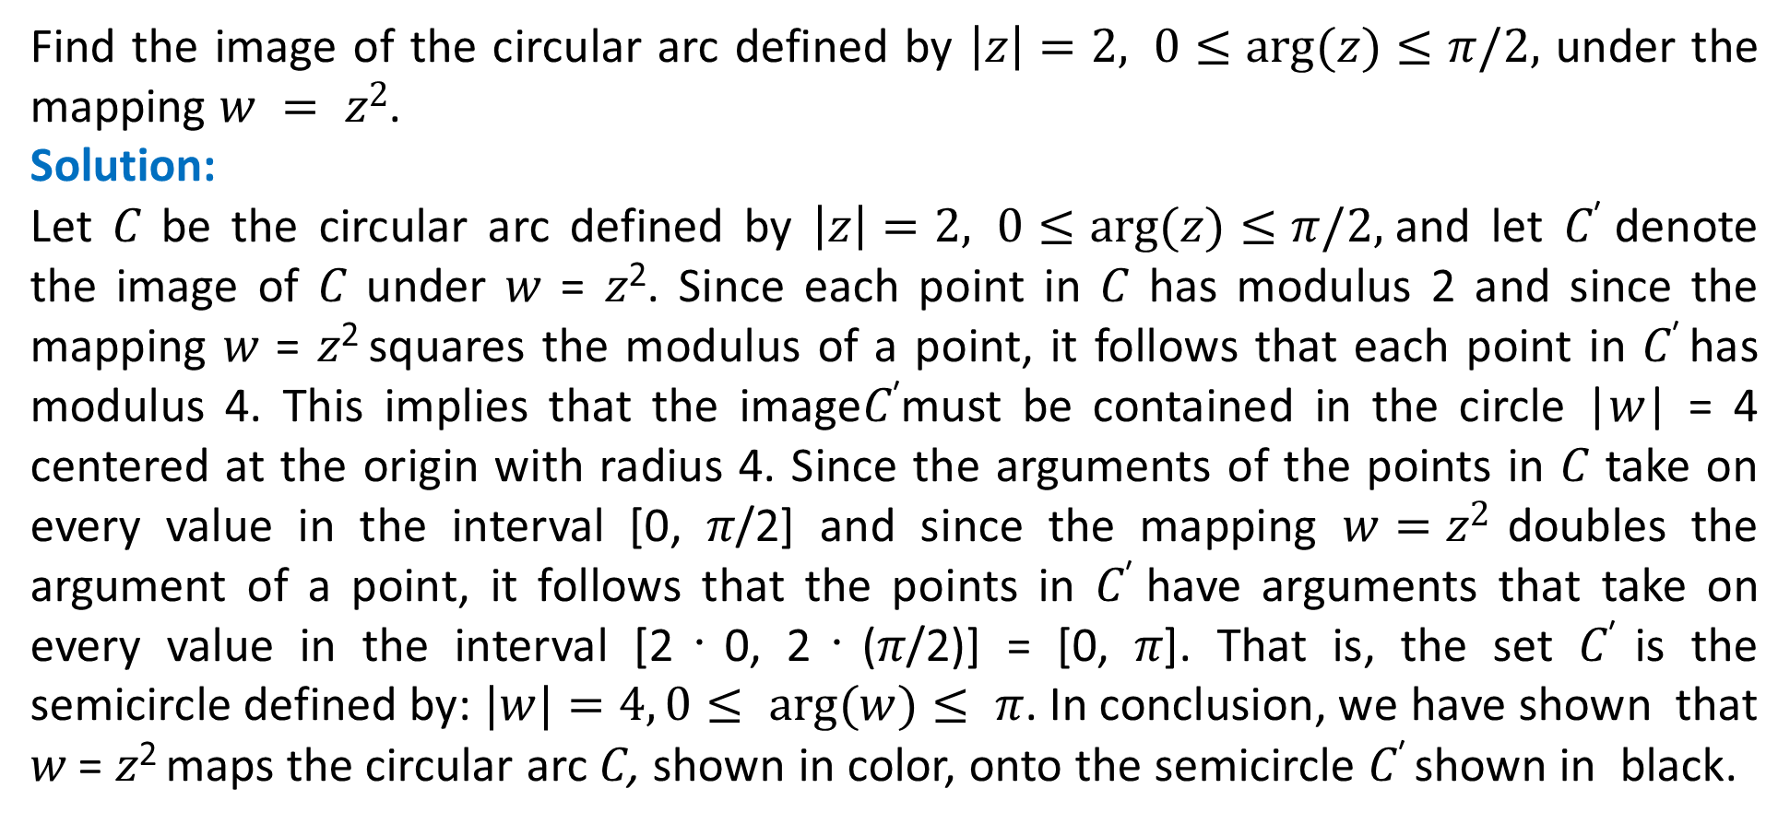
Example: Image of a Circular Arc under 𝒘 = 𝒛^{𝟐}
Find the image of the circular arc defined by $\left|z\right|=2, 0≤arg⁡(z)≤π/2,$ under the mapping $w = z2$.
Solution:
Let 𝐶 be the circular arc defined by $\left|z\right|=2, 0≤arg⁡(z)≤π/2,$and let 𝐶′ denote the image of 𝐶 under 𝑤 = 𝑧². Since each point in 𝐶 has modulus 2 and since the mapping 𝑤 = 𝑧² squares the modulus of a point, it follows that each point in 𝐶′ has modulus 4. This implies that the image𝐶′must be contained in the circle |𝑤| = 4 centered at the origin with radius 4. Since the arguments of the points in 𝐶 take on every value in the interval [0, 𝜋/2] and since the mapping $w=z2$ doubles the argument of a point, it follows that the points in 𝐶′ have arguments that take on every value in the interval [2・0, 2・(𝜋/2)] = [0, 𝜋]. That is, the set 𝐶′ is the semicircle defined by: $|w|=4, 0≤ arg⁡(w)≤ π$. In conclusion, we have shown that 𝑤 = 𝑧² maps the circular arc 𝐶, shown in color, onto the semicircle 𝐶′ shown in black.

Slide 36
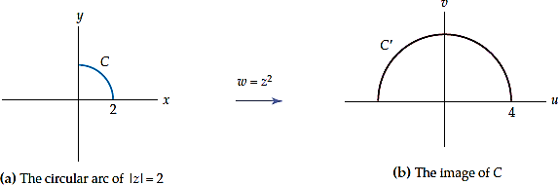
Example: Image of a Circular Arc under 𝒘 = 𝒛^{𝟐}

Slide 37
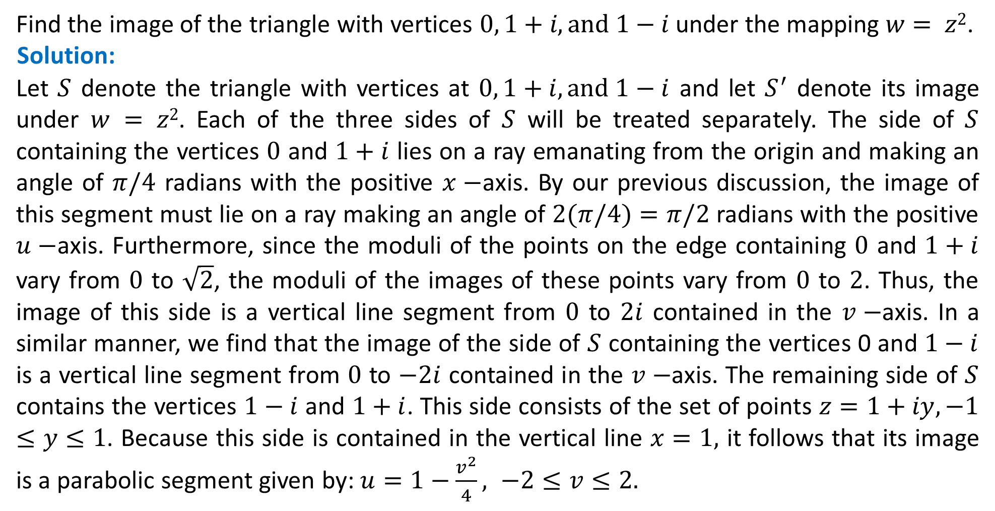
Example: Image of a Triangle under 𝒘 = 𝒛^{𝟐}
Find the image of the triangle with vertices $0, 1+i, and 1−i$under the mapping $w= z2$.
Solution:
Let $S$ denote the triangle with vertices at $0, 1+i, and 1−i$ and let $S^{′}$ denote its image under $w = z2$. Each of the three sides of $S$ will be treated separately. The side of $S$ containing the vertices $0$ and $1+i$ lies on a ray emanating from the origin and making an angle of $π/4$ radians with the positive $x−$axis. By our previous discussion, the image of this segment must lie on a ray making an angle of $2(π/4)=π/2$ radians with the positive $u−$axis. Furthermore, since the moduli of the points on the edge containing $0$ and $1+i$ vary from $0$ to $\sqrt{2}$, the moduli of the images of these points vary from $0$ to $2$. Thus, the image of this side is a vertical line segment from $0$ to $2i$ contained in the $v−$axis. In a similar manner, we find that the image of the side of $S$ containing the vertices 0 and $1−i$ is a vertical line segment from $0$ to $−2i$ contained in the $v−$axis. The remaining side of $S$ contains the vertices $1−i$ and $1+i$. This side consists of the set of points $z=1+iy, −1≤y≤1$. Because this side is contained in the vertical line $x=1,$ it follows that its image is a parabolic segment given by: $u=1−\frac{v^{2}}{4}, −2≤v≤2.$

Slide 38
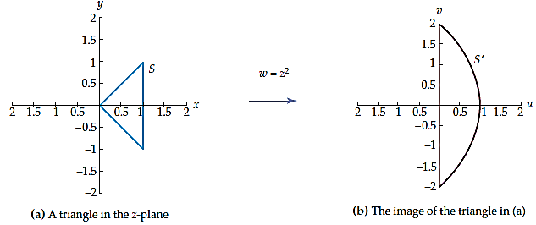
Example: Image of a Triangle under 𝒘 = 𝒛^{𝟐}

Slide 39

The Power Function $z^{n}, n>2$
An analysis similar to that used for the mapping $w=z^{2}$ can be applied to the mapping $w=z^{n}, n > 2$. By replacing the symbol $z$with $re^{iθ}$ we obtain:
$$w=z^{n}=r^{n}e^{inθ}. (5)$$
Consequently, if $z$ and $w=z^{n}$ are plotted in the same copy of the complex
plane, then this mapping can be visualized as the process of magnifying or
contracting the modulus $r$ of $z$ to the modulus $r^{n}$ of $w$, and by rotating $z$ about the origin to increase an argument $θ$ of $z$ to an argument $nθ$ of $w$.
We can use this description of $w=z^{n}$to show that a ray emanating from
the origin and making an angle of $φ$ radians with the positive $x−$axis is mapped onto a ray emanating from the origin and making an angle of $nφ$ radians with the positive $u−$axis.

Slide 40
Example: Image of a Circular Wedge under $w=z^{3}$
Determine the image of the quarter disk defined by the inequalities $|z|≤2,$ $0≤arg⁡(z)≤π/2,$ under the mapping $w= z3$.
Solution:
Let $S$ denote the quarter disk and let $S^{′}$ denote its image under $w= z3$. Since the moduli of the points in S vary from $0$ to $2$ and since the mapping $w= z3$ cubes the modulus of a point, it follows that the moduli of the points in $S^{′}$ vary from $0$ to $8$. In addition, because the arguments of the points in $S$ vary from $0$ to $π/2$ and because the mapping $w= z3$ triples the argument of a point, we also have that the arguments of the points in $S^{′}$ vary from $0$ to $3π/2$. Therefore, $S^{′}$ is the set given by the inequalities $|w| ≤ 8, 0 ≤ arg⁡(w) ≤ 3π/2$. Thus, the set $S$ shown in color in figure (a) is mapped onto the set $S^{′}$ shown in gray in figure (b) by $w= z3$.

Slide 41
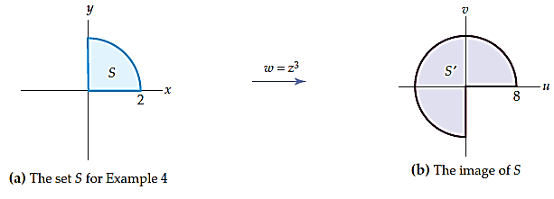
Example: Image of a Circular Wedge under $w=z^{3}$

Slide 42
The Power Function $z^{1/n}$
We now investigate complex power functions of the form $z^{1/n}$ where $n$ is an integer and $n≥2$. In a previous lecture we have seen that $n$ $nth$ roots of a nonzero complex number $z=r(cos⁡θ + i sin⁡θ)=re^{iθ}$ are given by:
$$r^{1/n}\left[\cos\left(\frac{θ+2kπ}{n}\right)+i\sin\left(\frac{θ+2kπ}{n}\right)\right]=r^{1/n}e^{i(θ+2kπ)/n},$$
where $k=0,1,2,…,n−1$. In particular, for $n=2$, the two square roots of $z$ are:
$$r^{1/2}\left[\cos\left(\frac{θ+2kπ}{2}\right)+i\sin\left(\frac{θ+2kπ}{2}\right)\right]=r^{1/2}e^{i(θ+2kπ)/2},$$
for $k=0,1$. The expression in above equation does not define a function because it assigns two complex numbers (one for $k=0$ and one for $k=1$) to the complex number $z$. However, by setting $θ=Arg(z)$ and $k=0$ we can define a function that assigns to $z$ the unique principal square root. Naturally, this function is called the principal square root function.

Slide 43
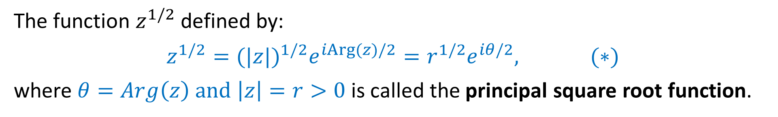
Principal Square Root Function $z^{1/2}$
The function $z^{1/2}$ defined by:
$$z^{1/2}={(|z|)}^{1/2}e^{iArg(z)/2}=r^{1/2}e^{iθ/2}, (∗)$$
where $θ=Arg\left(z\right) and \left|z\right|=r>0$is called the principal square root function.
Example: Values of $z^{1/2}$
Determine the values of the principal square root function $z^{1/2}$ at the following
points:
$$(a) z = 4 (b) z = −2i (c) z = −1 + i$$
Solution: $(c)$
For $z=−1+i,$ we have $|z|=√2$ and $Arg(z)=3π/4,$ and so from $(∗)$ we obtain:
$${(−1+i)}^{1/2}=2^{1/4}e^{i(3π/8)}≈ 0.4551 + 1.0987i.$$

Slide 44
Principal $nth$ Root Function $z^{1/2}$
For $n ≥ 2,$the function $z^{1/n}$ defined by:
$$z^{1/n}={(|z|)}^{1/n}e^{iArg(z)/n}=r^{1/n}e^{iθ/n}, (∗∗)$$
where $θ=Arg\left(z\right) and \left|z\right|=r>0$is called the principal $n$th root function.
Example: Values of $z^{1/2}$
Determine the values of the principal $n$th root function $z^{1/n}$ at the following
points:
$$\text{(}\text{a}\text{)} z^{1/3};z=i, \text{(}\text{b}\text{)} z^{1/5};z=1−i\sqrt{3}$$
Solution: $(a)$
For $z=i,$ we have $|z|=1$ and $Arg(z)=π/2,$ and so from $(∗∗)$ we obtain:
$${(i)}^{1/3}={(1)}^{1/3}e^{i(π/6)}=\frac{\sqrt{3}}{2}+i\frac{1}{2}.$$

Slide 45
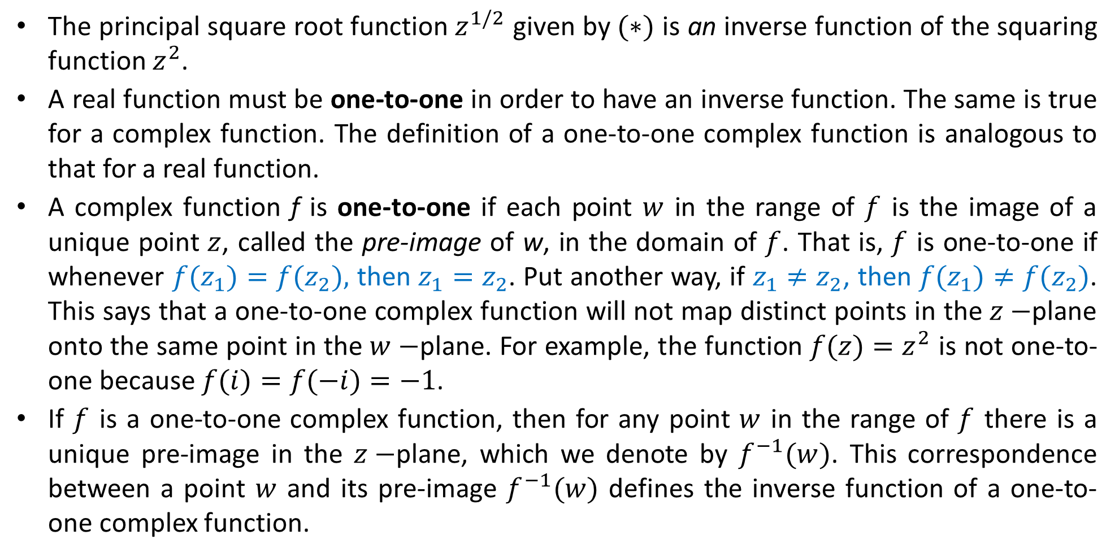
Inverse Function
The principal square root function $z^{1/2}$ given by $(∗)$ is an inverse function of the squaring function $z^{2}$.
A real function must be one-to-one in order to have an inverse function. The same is true for a complex function. The definition of a one-to-one complex function is analogous to that for a real function.
A complex function f is one-to-one if each point $w$ in the range of $f$ is the image of a unique point $z$, called the pre-image of w, in the domain of $f$. That is, $f$ is one-to-one if whenever $f(z_{1})=f(z_{2}),$ then $z_{1}=z_{2}$. Put another way, if $z_{1}≠z_{2}$, then $f(z_{1})≠f(z_{2})$. This says that a one-to-one complex function will not map distinct points in the $z−$plane onto the same point in the $w−$plane. For example, the function $f(z)=z^{2}$ is not one-to-one because $f(i)=f(−i)=−1$.
If $f$ is a one-to-one complex function, then for any point $w$ in the range of $f$ there is a unique pre-image in the $z−$plane, which we denote by $f^{−1}(w)$. This correspondence between a point $w$ and its pre-image $f^{−1}(w)$ defines the inverse function of a one-to-one complex function.

Slide 46
Inverse Function
If $f$ is a one-to-one complex function with domain $A$ and range $B$, then the inverse function of $f$ , denoted by $f^{−1}$, is the function with domain $B$ and range $A$ defined by:
$f^{−1}(z)=w$ if $f(w)=z$.
It follows immediately from this definition that if a set $S$ is mapped onto a set $S^{′}$ by a one-to-one function $f,$ then $f^{−1}$ maps $S^{′}$onto $S$. In other words, the complex mappings $f$and $f^{−1}$ “undo” each other. It also follows that if $f$ has an inverse function, then $f(f^{−1}(z))=z$ and $f^{−1}(f(z))=z$. That is, the two compositions $f◦f^{−1}$ and $f^{−1}◦f$ are the identity function.

Slide 47
Example: Inverse Function of $f\left(z\right)=z+3i.$
Show that the complex function $f(z)=z+3i$ is one-to-one on the entire complex plane and find a formula for its inverse function.
Solution:
One way of showing that f is one-to-one is to show that the equality $f(z_{1})=f(z_{2}),$ implies the equality $z_{1}=z_{2}$. For the function $f(z)=z+3i$, this follows immediately since $z_{1}+3i=z_{2}+3i$ implies that $z_{1}=z_{2}$. As with real functions, the inverse function of $f$ can often be found algebraically by solving the equation: $z=f(w)$ for the symbol $w$. Solving $z=w+3i$ for $w$, we obtain $w=z−3i$ and so,
$f^{−1}(z)=z−3i$.
Note: The mapping $f(z)=z+3i$ is a translation by $3i$ and that$f^{−1}(z)=z −3i$ is a translation by $−3i$. Suppose we represent these mappings in a single copy of the complex plane. Since translating a point by $3i$ and then translating the image by $−3i$ moves the original point back onto itself, we see that the mappings $f$ and $f^{−1}$ “undo” each other.

Slide 48
Inverse Functions of $z^{n}, n≥2$
We now discuss how to obtain an inverse function of $w=f(z)=z^{n}, n ≥ 2$. This requires some explanation since the function $f(z)=z^{n}, n ≥ 2,$is not one-to-one.
In order to see that this is so, consider the points $z_{1}=re^{iθ}$ and $z_{2}=re^{i(θ+2π/n)}$ with $r≠0$. Since $n≥2,$ the points $z_{1}$ and $z_{2}$ are distinct. That is, $z_{1}≠z_{2}$. Now $f(z_{1})=r^{n}e^{inθ}$and $f(z_{2})=r^{n}e^{i(nθ+2π)}=r^{n}e^{inθ}e^{i2π}=r^{n}e^{inθ}$. Therefore, $f$is not one-to-one since $f\left(z_{1}\right)=f(z_{2})$ but $z_{1}≠z_{2}$. In fact, the $n$ distinct points: $z_{1}=re^{iθ},z_{2}=re^{i(θ+2π/n)},z_{3}=re^{i(θ+4π/n)},…, z_{n}=re^{i(θ+2(n−1)π/n)}$, are all mapped onto the single point $w=r^{n}e^{inθ}$ by $f(z)=z^{n}$.
The preceding discussion appears to imply that the function $f(z)=z^{n}, n ≥ 2,$ does not have an inverse function because it is not one-to-one.
We have encountered this problem before, when defining inverse functions for certain real functions in elementary calculus. For example, the real functions $f(x)=x^{2}$ and $g(x)=\sin{x}$ are not one-to-one, yet we still have the inverse functions $f^{−1}(x)=√x$ and $g^{−1}(x)=arcsin⁡x$.

Slide 49

Inverse Functions of $z^{n}, n≥2$
The key to defining these inverse functions is to appropriately restrict the domains of the functions $f(x)=x^{2}$ and $g(x)=\sin{x}$to sets on which the functions are one-to-one.
For example, whereas the real function $f(x)=x^{2}$defined on the interval $(−∞,∞)$ is not one-to-one, the same function defined on the interval $[0,∞)$ is one-to-one. Similarly, $g(x)=\sin{x}$is not one-to-one on the interval $(−∞,∞),$ but it is one-to-one on the interval $[−π/2, π/2].$
The function $f^{−1}(x)=√x$ is the inverse function of the function $f(x)=x^{2}$defined on the interval $[0, ∞)$. Since $Dom(f)=[0,∞)$ and $Range(f)=[0, ∞),$ the domain and range of $f^{−1}(x)=√x$ are both $[0,∞)$ as well.
In a similar manner, $g^{−1}(x)=arcsin⁡x$ is the inverse function of the function $g(x)=\sin{x}$defined on $[−π/2,π/2]$. The domain and range of $g^{−1}$ are $[−1, 1]$ and $[−π/2,π/2]$, respectively.
We use this same idea for the complex power Function. In order to define an inverse function for $f(z)=z^{n}, n ≥ 2$, we must restrict the domain of $f$ to a set on which $f$ is a one-to-one function.

Slide 50


Slide 51


Slide 52
Linear Mappings
Recall that a real function of the form $f(x)=ax+b$where $a$ and $b$ are any real constants is called a linear function.
Keeping in view the similarities between real and complex analysis, we define a complex linear function to be a function of the form $f(z)=az+b$ where $a$ and $b$ are any complex constants.
Before looking at a general complex linear mapping $f\left(z\right)=az+b,$ we investigate three special types of linear mappings called translations, rotations, and magnifications, because every non-constant complex linear mapping can be described as a composition of these three mappings.

Slide 53

Translations
A complex linear function
$$T(z)=z+b, b ≠ 0, (1)$$
is called a translation. If we set $z=x+iy$ and $b=x_{0}+iy_{0}$ in (1), then we obtain
$$T(z)=(x+iy)+(x_{0}+iy_{0})=x+x_{0}+i(y+y_{0}).$$
Thus, the image of the point $(x, y)$under $T$ is the point $\left(x+x_{0},y+y_{0}\right).$ Therefore, the linear mapping $T(z)=z+b$ can be visualized in a single copy of the complex plane as the process of translating the point $z$ along the vector $\left(x_{0},y_{0}\right)$to the point $T(z)$. The mapping $T(z)=z + b$is also called a translation by b.
Note: a translation does not change the shape or size of a figure in the complex plane. A mapping with this property is sometimes called a rigid motion.

Slide 54

Example:
Find the image $S^{′}$ of the square $S$ with vertices at $1+i, 2+i, 2+2i,$and $1+2i$under the linear mapping $T(z) = z +2−i.$
Solution: We will represent S and $S^{′}$ in the same copy of the complex plane. For the present case, the mapping $T$ is a translation with $b = 2−i.$ Therefore,
$T\left(1 + i\right)=\left(1+i\right)+\left(2−i\right)=3;$ $T\left(2+i\right)=\left(2+i\right)+\left(2−i\right)=4;$
$T\left(2+2i\right)=\left(2+2i\right)+\left(2−i\right)=4+i;$ $T(1 + 2i)=(1+2i)+(2−i)=3+i.$
Therefore, the square S shown in color in figure is mapped onto the square $S^{′}$ shown in black by the translation $T(z)=z+2−i$.

Slide 55
Rotations
A complex linear function
$$R\left(z\right)=az, |a|=1, (2)$$
is called a rotation. Keep in mind that the constant $a$ in (2) is a complex constant.
Case1: Consider the rotation $R$ given by $(2)$ and assume that $Arg(a)>0$. Since $|a|=1$ and $Arg(a)>0$, we can write $a$ in exponential form as $a=e^{iθ}$ with $0 < θ ≤ π$. If we set $z=re^{iφ},$ then from $(2)$ we obtain the following description of $R$:
$$R\left(z\right)=e^{iθ}re^{iφ}=re^{i(θ+φ)}. (3)$$
From $(3)$, we see that the $\left|R\left(z\right)\right|=r=\left|z\right|,$ therefore, if $z$ and $R(z)$ are plotted in the same copy of the complex plane, then both points lie on a circle centered at $0$ with radius $r$. Also, argument of $R(z)$ is $θ+φ,$ which is $θ$ radians greater than an argument of $z$. Therefore, the linear mapping $R(z)=az$ can be visualized in a single copy of the complex plane as the process of rotating the point $z$ counterclockwise through an angle of $θ$ radians about the origin to the point $R(z)$.

Slide 56


Rotations
Case2: In a similar manner, if $Arg(a)<0,$ then the linear mapping $R(z)=az$ can be visualized in a single copy of the complex plane as the process of rotating points clockwise through an angle of $θ$ radians about the origin. For this reason the angle
$θ=Arg(a)$is called an angle of rotation of R.
Note: As with translations, rotations will not change the shape or size of a figure in the complex plane. Thus, the image of a line, circle, or triangle under a rotation will also be a line, circle, or triangle, respectively.

Slide 57


Example:
Find the image of the real axis y = 0 under the linear mapping
$$R\left(z\right)=\frac{1}{\sqrt{2}}\left(1+i\right)z.$$
Solution: Let $C$ denote the real axis $y = 0$and let $C^{′}$ denote the image of $C$ under $R$. Here, $\left|a\right|=\left|\frac{1}{\sqrt{2}}\left(1+i\right)\right|=1,$ the complex mapping $R(z)$is a rotation. In order to determine the angle of rotation, we express $a$ in exponential form$a=e^{iπ/4}.$ If $z$ and $R(z)$ are plotted in the same copy of the complex plane, then the point z is rotated counterclockwise through $π/4$ radians about the origin to the point $R(z)$. The image$C^{′}$is, therefore, the line $v=u$, which contains the origin and makes an angle of $π/4$ radians with the real axis.

Slide 58

Magnifications
A complex linear function
$$M\left(z\right)=az, a>0, (4)$$
is called a magnification. Since there is no concept of order in the complex numbers, it is implicit in the inequality $a>0$ that the symbol $a$ represents a real number. Therefore, if $z=x+iy,$ then $M(z)=az=ax+iay$, and so the image of the point $(x,y)$ is the point $(ax,ay)$. Using the exponential form $z=re^{iθ}$of $z$, (4) can be rewritten as:
$$M\left(z\right)=(ar)e^{iθ}. (5)$$
From $(5)$, we see that $z$ and $M(z)$ have the same argument $θ,$but have different moduli, since, $\left|M\left(z\right)\right|=ar$ which is different from $\left|z\right|=r.$

Slide 59

Magnifications
Case 1: a > 1.
If we plot both $z$ and $M(z)$in the same copy of the complex plane, then $M(z)$is the unique point on the ray emanating from $0$ and containing $z$ whose distance from $0$ is $ar$.
Since $a>1,$ $M(z)$is $a$ times farther from the origin than z. Thus, the linear mapping $M(z)$ can be visualized as the process of magnifying the modulus of the point $z$by a factor of $a$ to obtain the point $M(z)$. The real number a is called the magnification factor of M.
Case 2: $0<a<1.$
If $0<a<1,$ then the point $M(z)$ is $a$ times closer to the origin than the point $z$. This special case of a magnification is called a contraction.
Note: Although a magnification mapping will change the size of a figure in the complex plane, it will not change its basic shape.

Slide 60


Example:
Find the image of the circle $C$ given by $|z|=2$ under the linear mapping $M(z)=3z.$
Solution: Since $M(z)$ is a magnification with magnification factor of $3$, each point on the circle $|z|=2$will be mapped onto a point with the same argument but with modulus magnified by $3$. Thus, each point in the image will have modulus $3・2 =6$. The image points can have any argument since the points $z$ in the circle $|z|=2$ can have any argument. Therefore, the image $C^{′}$ is the circle $|w|=6$ that is centered at the origin and has radius $6$.
Under the mapping $M(z)=3z,$ the circle $C$ shown in color is mapped onto the circle $C^{′}$ shown in black.

Slide 61

Linear Mappings
If $f$ and $g$ are two functions, then the composition of $f$ and $g$ is the function defined by:
$f◦g\left(z\right)=f\left(g\left(z\right)\right).$
The value $w=f ◦ g(z)$is determined by first evaluating the function $g$ at $z$, then evaluating the function $f$at $g(z)$. In a similar manner, the image, $S^{′′}$, of set $S$ under a composition $w=f◦g(z)$is determined by first finding the image, $S^{′},$ of $S$ under $g$, and then finding the image $S^{′′}$ of $S^{′}$ under $f$.
Now consider a complex linear function
$f\left(z\right)=az+b; a≠0;$
Otherwise, our mapping would be the constant map $f\left(z\right)=b,$ which maps every point in the complex plane onto the single point $b$. Observe that we can express $f$ as:
$$f\left(z\right)=az+b=\left|a\right|\left(\frac{a}{\left|a\right|}z\right)+b. (6)$$
Now, step by step, we investigate what happens to a point $z_{0}$ under the composition in (6).

Slide 62

Image of a Point under a Linear Mapping:
Let $f(z)=az+b$ be a linear mapping with $a≠0$and let $z_{0}$be a point in the complex plane. If the point $w_{0}=f(z_{0})$is plotted in the same copy of the complex plane as $z_{0}$, then $w_{0}$ is the point obtained by:
(i ) rotating $z_{0}$ through an angle of $Arg(a)$ about the origin,
(ii) magnifying the result by $|a|,$and
(iii) translating the result by $b$.
This description of the image of a point $z_{0}$ under a linear mapping also describes the image of any set of points $S$. In particular, the image, $S^{′}$, of a set $S$ under the non-constant complex linear mapping $w=f(z)=az+b$ is the set of points obtained by rotating $S$ through
$Arg(a),$ magnifying by $|a|$, and then translating by $b$.
Note: A complex linear mapping $w=az+b$with $a≠0$can distort the size of a figure in the complex plane, but it cannot alter the basic shape of the figure.

Slide 63

Example:
Find the image of the rectangle with vertices $−1+i, 1+i, 1+2i,$and $−1+2i$ under the linear mapping $f(z)=4iz+2+3i.$
Solution: We will represent S and $S^{′}$ in the same copy of the complex plane. Given that $f$ is a linear mapping, this implies that $S^{′}$ has the same shape as $S$. That is, $S^{′}$ is also a rectangle. Thus, in order to determine $S^{′}$, we only need to only find its vertices, which are the images of the vertices of $S$ under $f$:
$$f(−1+i)=−2−i; f(1+i)=−2+7i;$$
$$f(1 + 2i)=−6+7i; f(−1+2i)=−6−i.$$
Therefore, $S^{′}$ is the rectangle with vertices $−2−i, −2+7i, −6+7i,$and $−6−i$.

Slide 64


The linear mapping $f(z)=4iz+2+3i$ can also be viewed as a composition of a rotation, a magnification, and a translation. Because $Arg(4i)=π/2$ and $|4i|=4,$ $f$ acts by rotating through an angle of $π/2$ radians about the origin, magnifying by $4$, then translating by $2+3i.$

